Slide 1
ChatGPT for Teachers
Welcome!
#MNCODES
Notes:
Presentation for April 15th, 2023

Slide 2
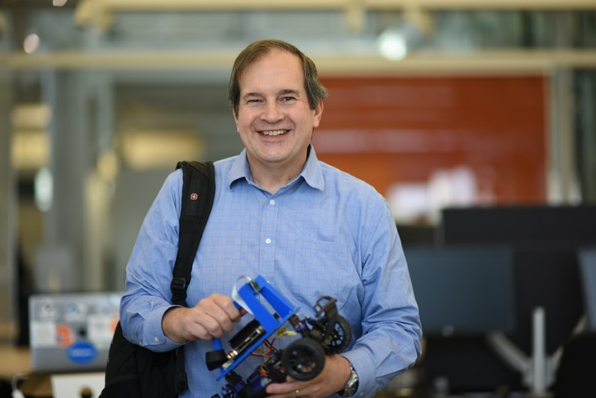
Dan McCreary
He/him
Code Savvy/Optum
Contact: https://www.linkedin.com/in/danmccreary/

Slide 3
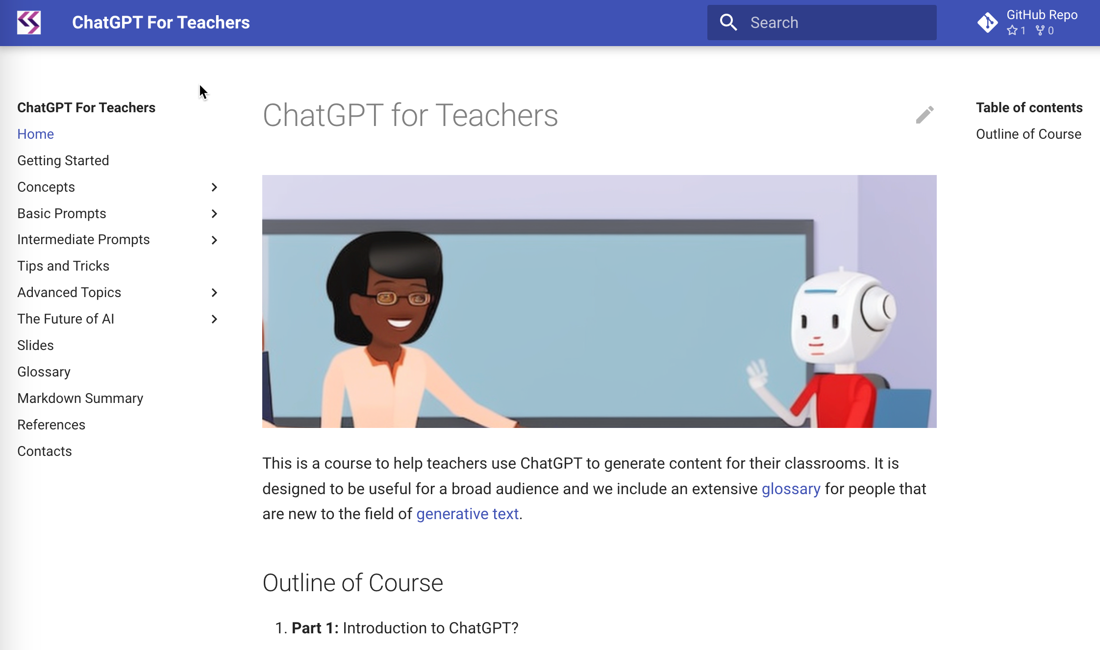
Supporting Website
ChatGPT for Teachers
http://www.coderdojotc.org/chatgpt-for-teachers/
Search
GitHub
Navigation

Slide 4
Agenda
Ethics First: When should we use technology and AI in the classroom?
What is ChatGPT and generative AI?
Examples:
Computational thinking topics
Code of conduct lab
Generating lesson plans
Generating sample code
Generating “hands on” interactive web examples
Explaining linear regression
Generating stories and using metaphors and analogies
Future Direction
Ethics Wrap up

Slide 5
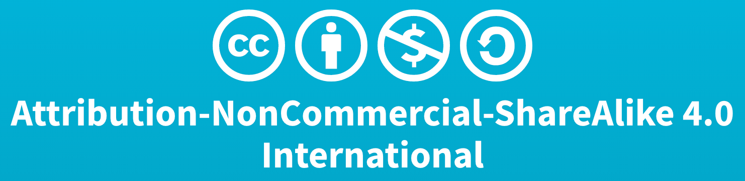
Content Licenses
All content presented is my own original content with some portions of text and code generated by ChatGPT
Images are generated by Stable Diffusion 2.1 with some editing
You are welcome to reuse the examples in your classrooms with the following constraints
Acknowledgement is always appreciated
You can’t resell this content for profit
https://creativecommons.org/licenses/by-nc-sa/4.0/legalcode

Slide 6
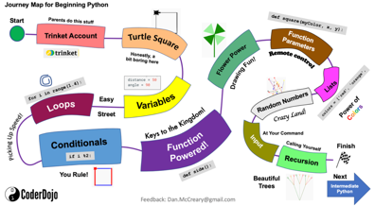
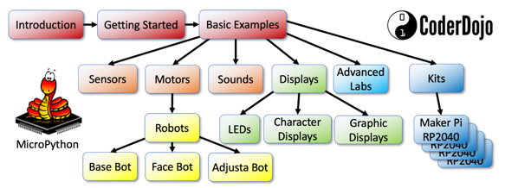
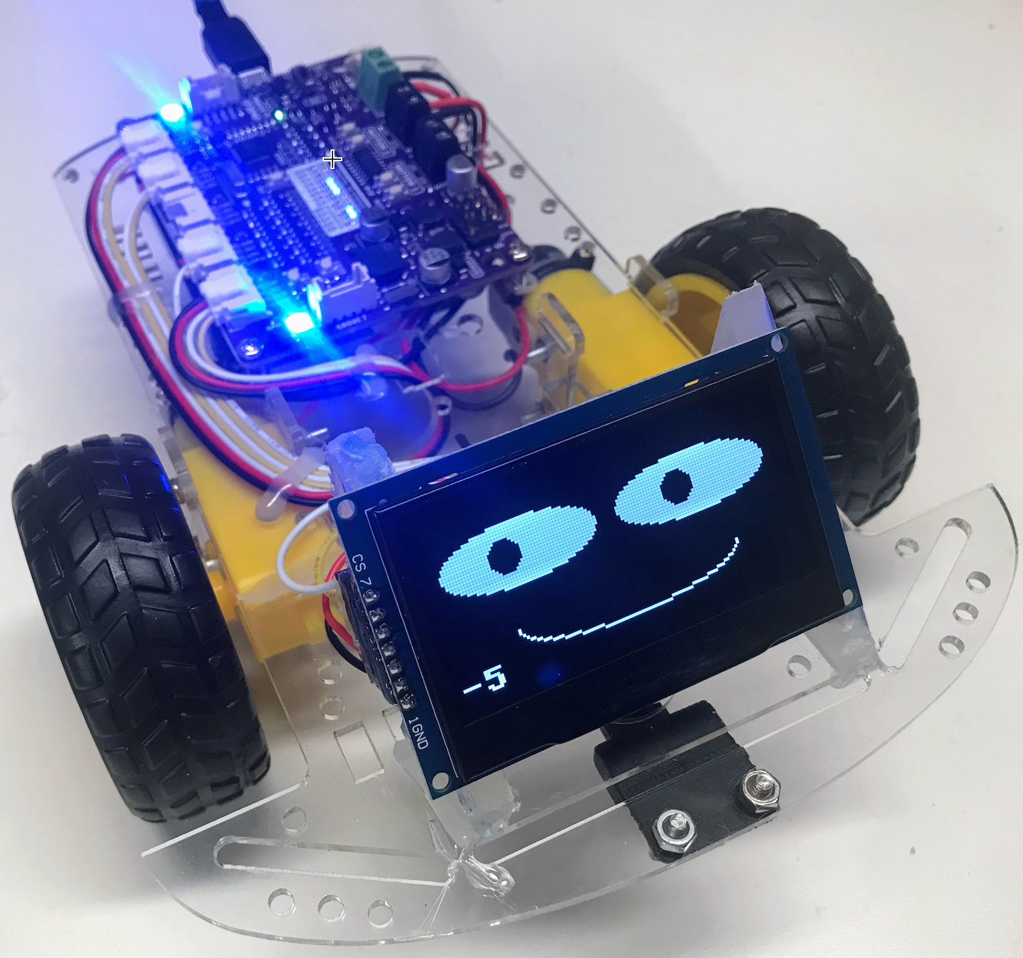
About Me
Teaching Computational Thinking since 2014
CoderDojo / Code Savvy / Optum Robots
Day job: Distinguished Engineer at Optum Technology
Lead the “ChatGPT Center of Good”
Champion of Shared Lesson Plans for Girls/Disadvantaged Youth
Python
MicroPython
Low-Cost Robots
https://dmccreary.github.io/dmccreary

Slide 7
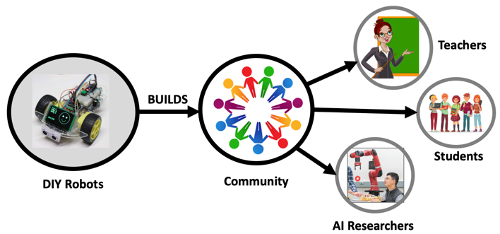
Personal Goal: Connect with Others!
Dec 29, 2018
https://dmccreary.medium.com/building-an-ai-community-with-diy-robotics-part-1-the-donkey-car-d285579985f1

Slide 8
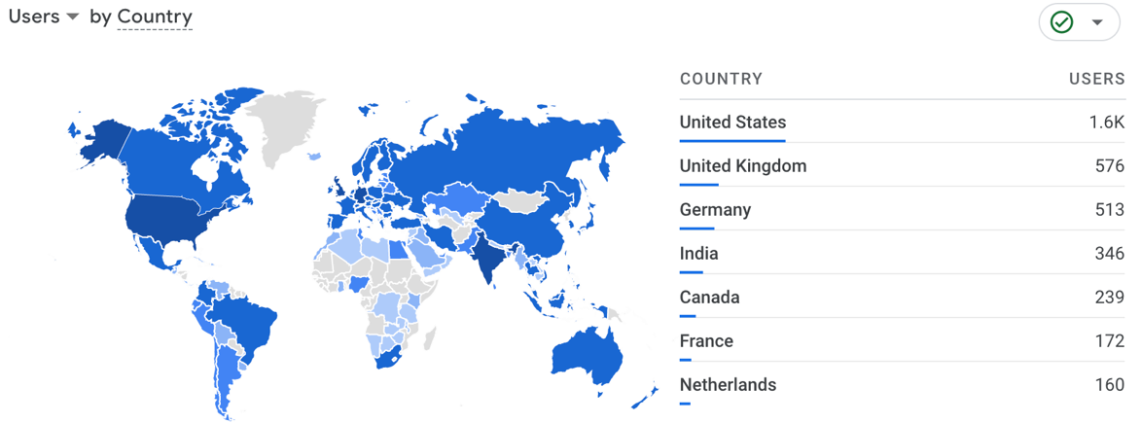
Over 10K Users in 97 Countries
MicroPython site usage over prior 90 days (Google Analytics)
mkdocs.yml
extra:
analytics:
provider: google
property: G-EP38Z3PVD5

Slide 9
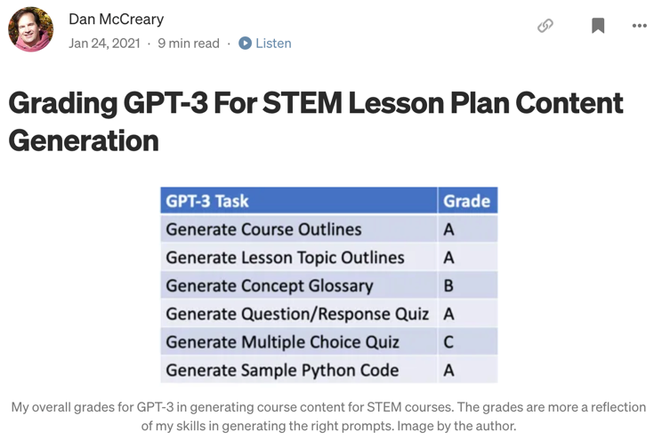
Blog Published in January 2021
Nov. 2022
GPT-4?
ChatGPT
A
A
A
A
B
A
?
GPT-3 only got “A”s in 4 out of 6 challenges
ChatGPT (Nov. 30th, 2022) would get almost all “A”s – 18 months

Slide 10
Ethics of Generative AI
When is it ethical to use:
Calculators in the classroom
E-Mail vs. hand-written notes
Wikipedia to do research vs going to your local library
Google search for sample code
Spell checkers
Writing aids (Grammarly)
Outline generators
Full generative text
When should we disclose our use of these tools?
When are we avoiding interpersonal contact when using these tools?

Slide 11
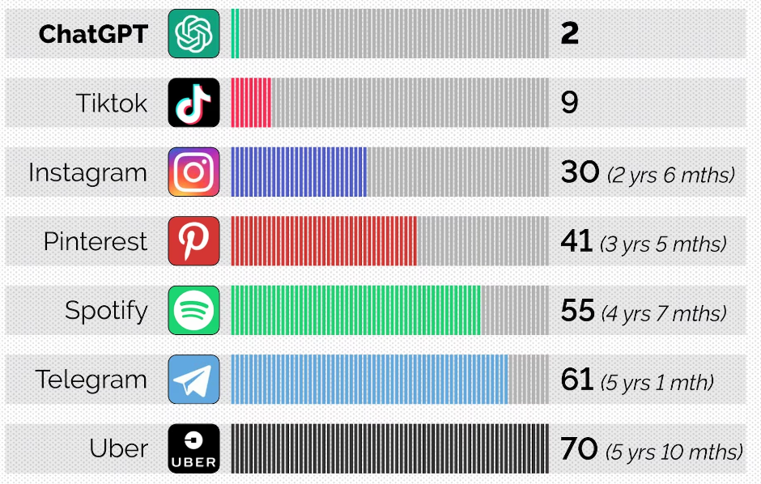
Fastest Time to 100M Users
Source: CNBC
Notes:
https://www.cnbctv18.com/technology/chatgpt-sets-record-for-fastest-growing-user-base-says-study-15840751.htm

Slide 12
What is ChatGPT?
A type of “Generative AI”
Built on large-language model (LLM)
Text to Anything
Text to images
Text to software code
Text to interactive graphics
Input: Prompt
Instructions on what you want
Examples of the format you want it
Description of your audience (For a 5th grade class)
The style or perspective you want to take
Response: What you want to generate
Documents, letters, outlines, code, stories, metaphors
Large
Language
Model
Prompt
Response

Slide 13
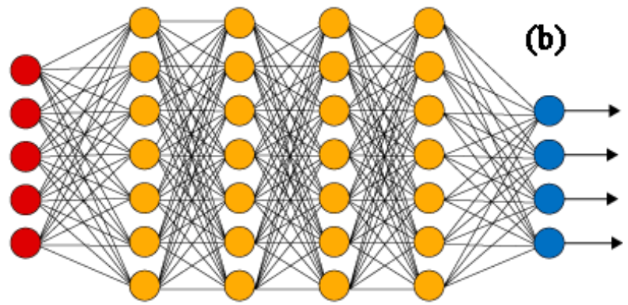
Large Language Model: What is the next token?
Input
Prompt
Next
Token
Input prompts are input to a neural network and are used to predict the next word (token).

Slide 14
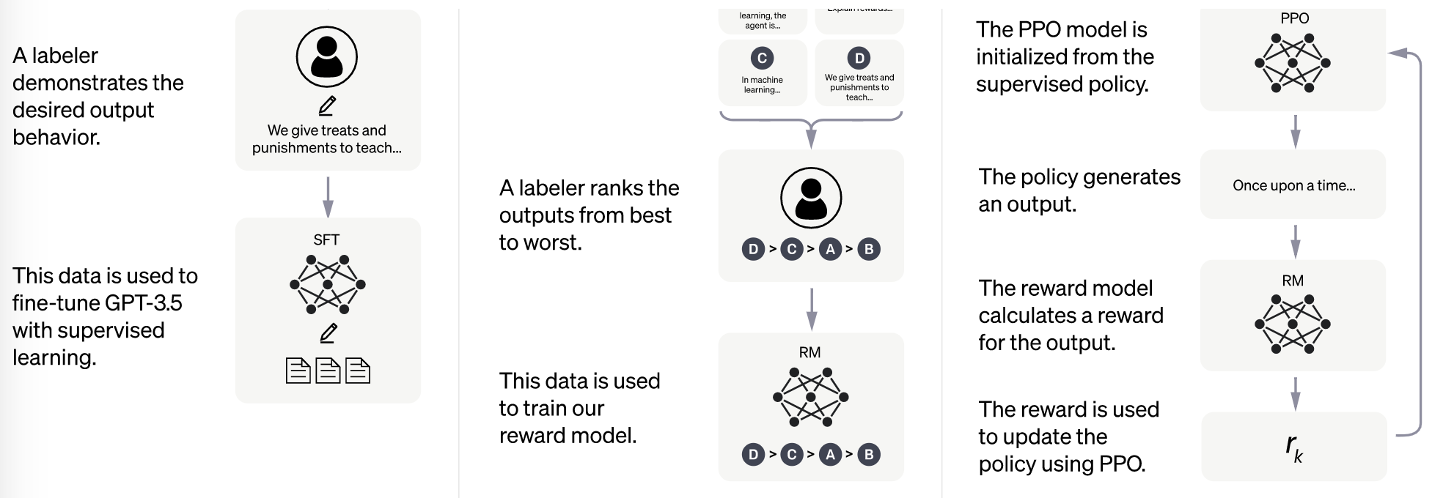
Reinforcement Learning with Human Feedback
Source: https://openai.com/blog/chatgpt

Slide 15
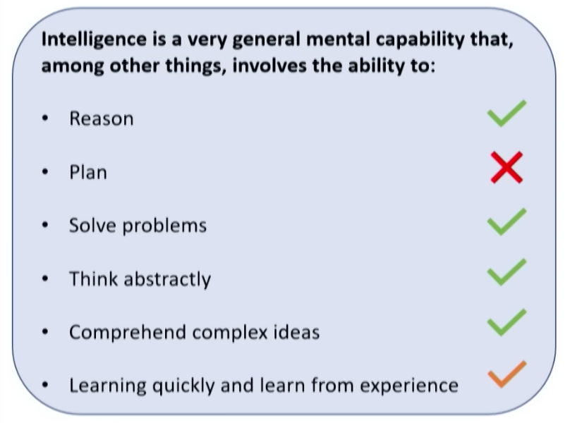
Is GPT “Intelligent”?
Is this still true after AUTO-GPT?
Annual updates
https://youtu.be/qbIk7-JPB2c?t=1000

Slide 16
ChatGPT for Teachers
Pros
Many tasks can be semi-automated
Your ”helper” is always there for you
Story: Teaching made easy with ChatGPT!
Lesson planning, grading, and writing comments to parents are now automated, reducing stress by 95%.
Cons
No easy way to tell when ChatGPT is telling the truth
Verification can take time
Content is “frozen in time” from September 2021
Notes:
https://www.reddit.com/r/ChatGPT/comments/12a3b9z/chatgpt_as_a_teacher_where_have_you_been_all_of/

Slide 17
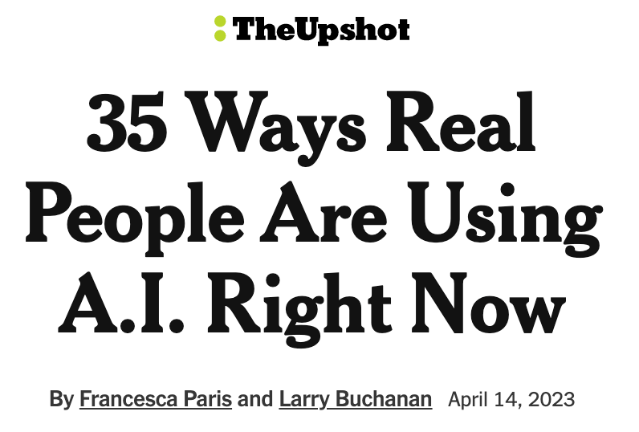
From New York Times Yesterday
“It’s like collaborating with an alien.”
“Everything is becoming much easier.”
“It feels like I’ve hired an intern.”
“What used to take me around a half-hour to write now takes one minute.”
“It’s enormous fun.”
https://www.nytimes.com/interactive/2023/04/14/upshot/up-ai-uses.html

Slide 18
What is Computational Thinking?
Prompt: What are the key concepts in teaching computational thinking?
Response:
Decomposition: Breaking down complex problems …
Abstraction: Focusing on the essential details and ignoring non-essential details.
Pattern recognition: Identifying common patterns in data…
Algorithmic thinking: Developing a step-by-step process…
Debugging: Finding and fixing errors in code or algorithms.
Automation: Using computers and algorithms to automate tasks…
Data analysis: Collecting, organizing, and analyzing data…
Computational creativity: …develop new and innovative solutions to problems.
Trivia: Generative AI trained on code give better results

Slide 19
What is Computational Thinking? Full Response
Computational thinking refers to the mental processes used by computer scientists and programmers to solve problems and create algorithms. Here are some key concepts that can be useful in teaching computational thinking:
Decomposition: Breaking down complex problems into smaller, more manageable parts or sub-problems.
Abstraction: Focusing on the essential details and ignoring non-essential details.
Pattern recognition: Identifying common patterns in data or problems and developing solutions based on those patterns.
Algorithmic thinking: Developing a step-by-step process or algorithm for solving problems.
Debugging: Finding and fixing errors in code or algorithms.
Automation: Using computers and algorithms to automate tasks that would otherwise be time-consuming or difficult for humans.
Data analysis: Collecting, organizing, and analyzing data to extract meaningful insights.
Computational creativity: Using computational thinking to develop new and innovative solutions to problems.
When teaching computational thinking, it is important to emphasize these concepts and provide opportunities for students to practice them through hands-on activities, projects, and challenges.

Slide 20
Have Students Draft Their Own Code of Conduct
Prompt: Create a code of conduct for a junior high school classroom.
Include topics of values, diversity and respect.
Return the results in markdown format.
Discussion: when is it ethical to have ChatGPT help you write a letter to parents about interventions?

Slide 21
Code of Conduct
Prompt: Create a code of conduct policy for a 9th grade programming class
Response:
Respectful Behavior
Academic Honesty
Attendance and Participation
Use of Technology
Completion of Assignments
Respect for Property
Communication
Safety
Consequences
Discussion Question: Can generative AI help us create a more ethical society?

Slide 22
Pick a License for Your Lesson Plans
Prompt: I am a teacher that is creating new lesson plans. I want other teachers to be able to reuse my content and modify it for their classrooms. However, I want them to give me attribution and I don't want anyone to be able to resell my content.
Response: The Creative Commons Attribution Non-Commercial Share-Alike 4.0 International (CC BY-NC-SA 4.0) license would be the best option for you. …
Details: http://www.coderdojotc.org/chatgpt-for-teachers/prompts/03-license/

Slide 23
Lesson Plan Prompt
Design a lesson plan about topic A with B goals, C accommodations, and D time limit. Finally, to do E and F differentiation, and accommodating students with G, H, and I special needs.
30 seconds later a perfectly worded lesson plan appears before me. I could do that myself, but it could take an hour. What would take me an hour before now takes mere seconds.
Source: Redditor SquatDeadliftBench on April 2nd, 2023 – 470+ comments

Slide 24
Prompt Template:
I want you to act as a lesson plan generator for English language learners. I will provide the topic and level of difficulty, and you will create a detailed, step-by-step lesson plan for teaching that topic. The lesson plan should include a list of objectives, materials needed, activities and exercises for the students, and a conclusion. Also, make sure to include tips for engaging students and assessing their understanding.
Topic:
Grade Level:

Slide 25
Generating Coding Lesson Plans
Prompt: Create a detailed lesson plan for teaching loops in Python
for a junior high-school students about 12 years old.
Assume the student has already had a basic introduction
to Python and has had lessons on:
1. Syntax
2. Conditionals
Generate sample Python code within markdown that will include
an input list of colors (red, green blue etc.) and show how
to loop through the list of colors to print them each out.
Results: http://www.coderdojotc.org/chatgpt-for-teachers/prompts/06-lessons/

Slide 26
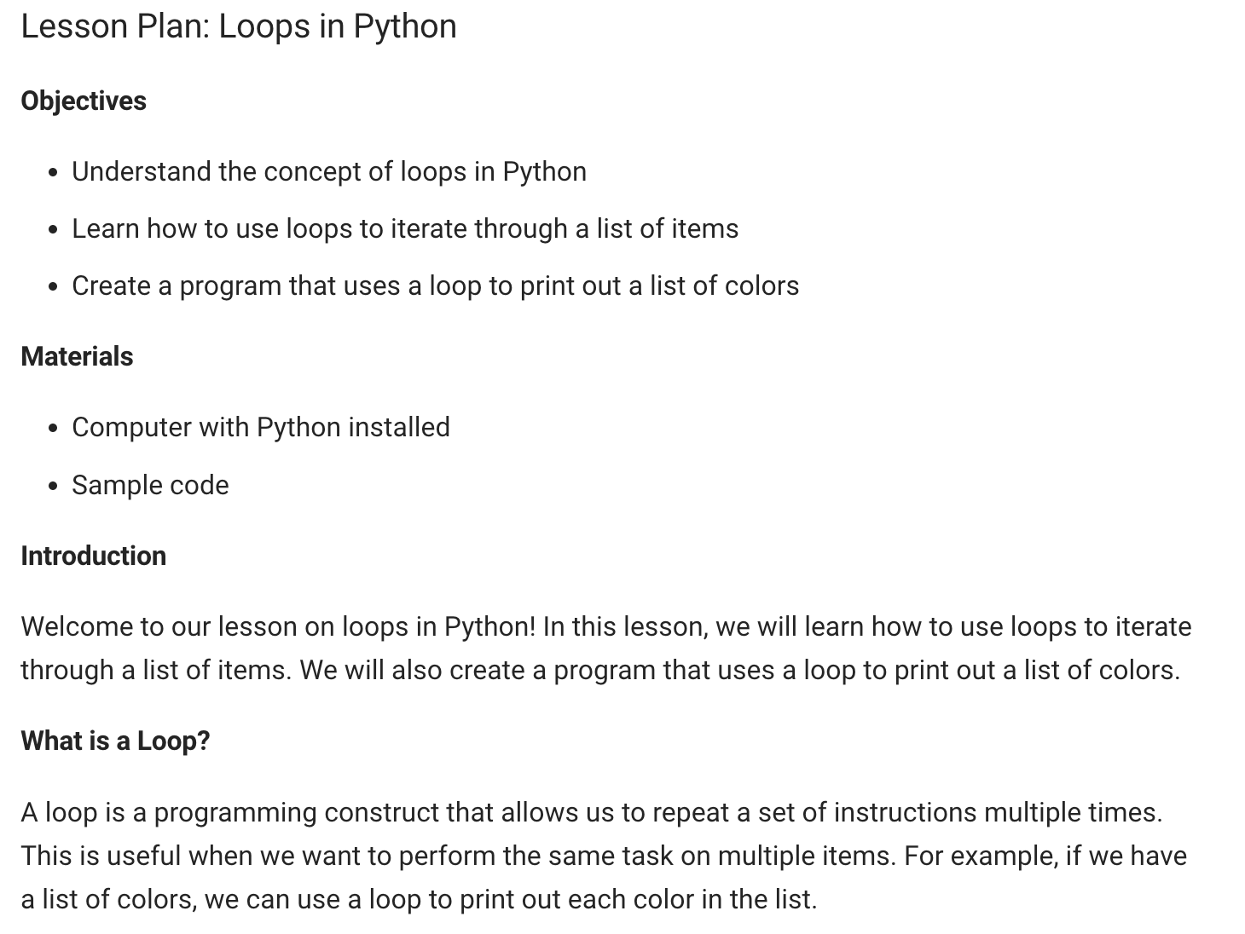
Sample Response

Slide 27
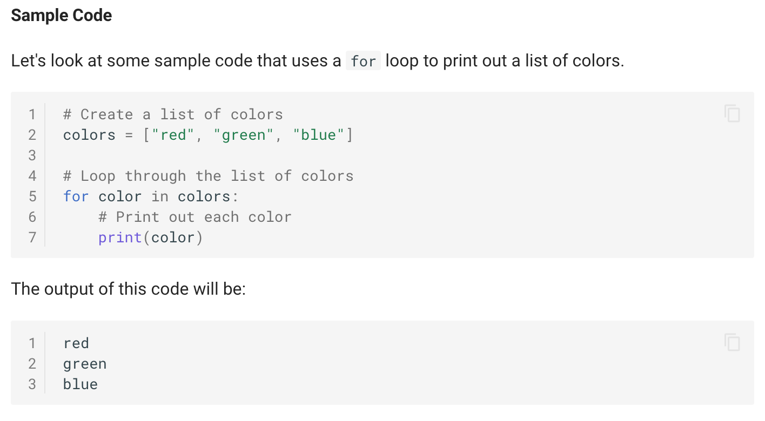
Sample Response (continued)
Copy
Text
Button

Slide 28
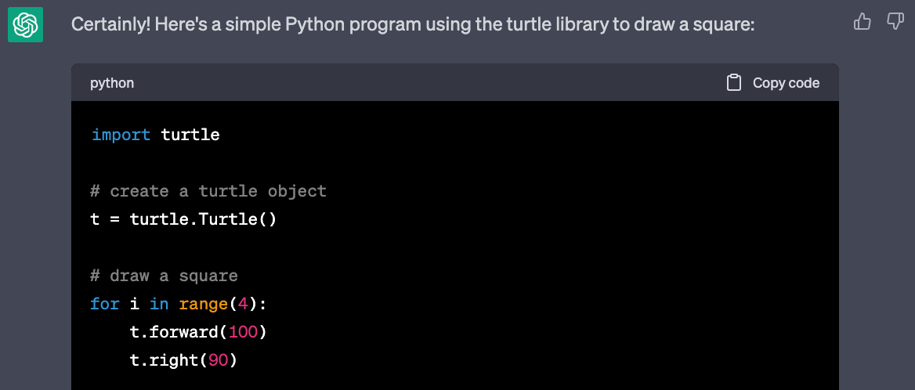
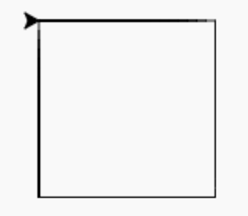
Generating Sample Code
Prompt: Create a Python program using the turtle library to draw a square.
Copy Code Button
Copy code and paste into Trinket.io
https://trinket.io/library/trinkets/ea571870b9

Slide 29

Rainbow Boxes
Prompt: Generate a sample python program using the turtle library that will draw 7 boxes filled with the colors of the rainbow. Start at (-200,0) and make the boxes 50 on each side. Space the boxes 55 apart.
Don't bother with the setup including screen size, background color and title.
http://www.coderdojotc.org/chatgpt-for-teachers/prompts/09b-rainbow-boxes/

Slide 30
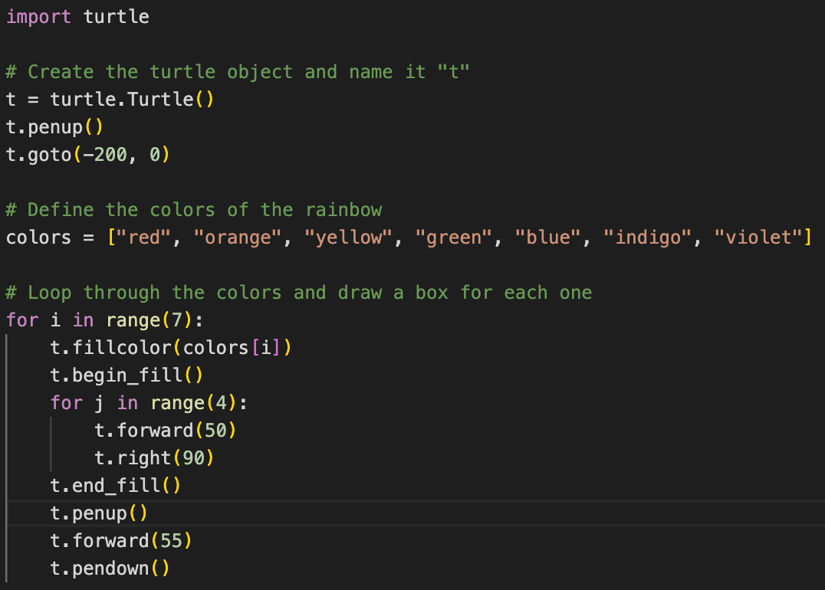
Rainbow Boxes Source

Slide 31
Listing Common Misunderstandings
List the most common ways that high school computer science students misunderstand concept X. For each way, briefly explain what students may erroneously think, then give the correct understanding.

Slide 32
Common Misunderstandings about Objects
Prompt: List the most common ways that high school computer science students misunderstand concept object-oriented programming. For each way, briefly explain what students may erroneously think, then give the correct understanding.
Confusing classes with objects
Not understanding inheritance
Not grasping the concept of encapsulation
Not understanding polymorphism
Not fully understanding the concept of abstraction
To overcome these misconceptions, students should focus on understanding the fundamental concepts of object-oriented programming and practice writing code that uses these concepts. They should also seek help from teachers, tutors, or online resources if they need further clarification.

Slide 33
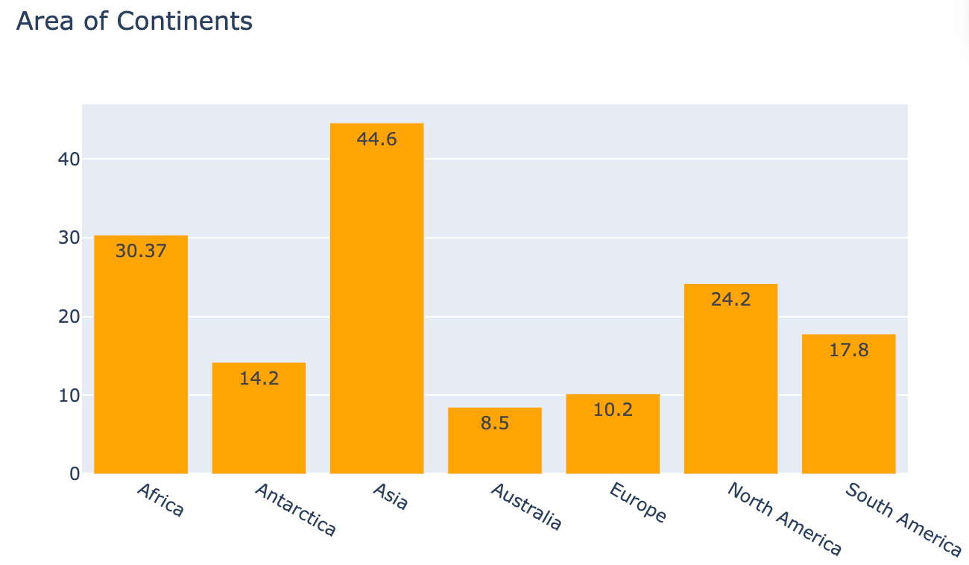
Simple Charts
Prompt: Create a Python plotly program to draw a vertical bar chart showing the area of all the continents.
I use Visual
Studio Code
Configure
Copy Code
Run

Slide 34
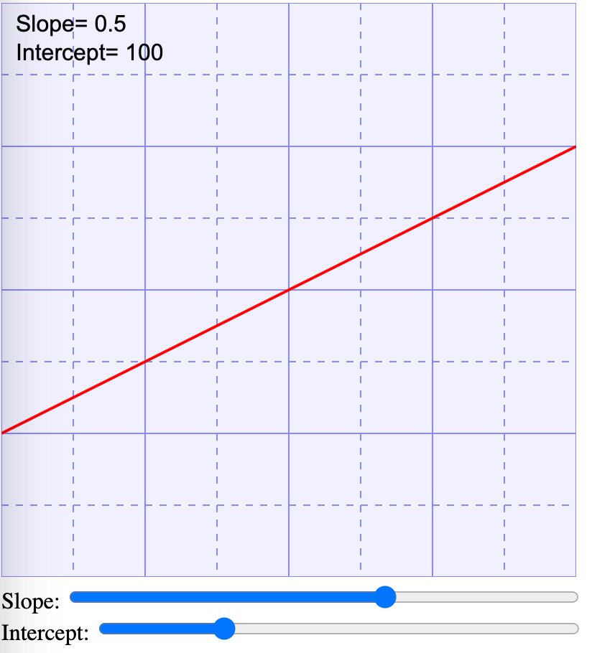
Generating Interactive “Hands-On” Labs
Prompt: Create an interactive web application that demonstrates the slope and intercept concepts. Create two range sliders for slope and intercept
Interactive Controls!
http://www.coderdojotc.org/chatgpt-for-teachers/prompts/10-slope-and-intercept/

Slide 35
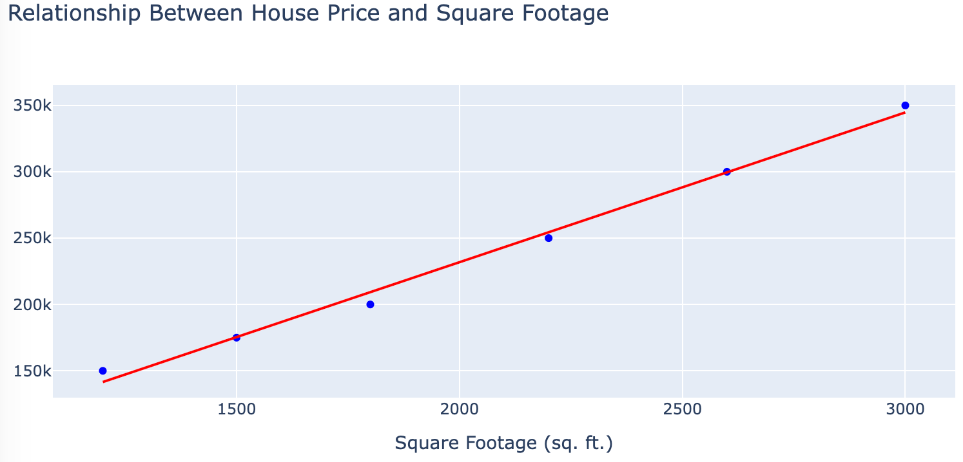
Teaching Linear Regression
Linear regression is the “gateway” to prediction and AI

Slide 36
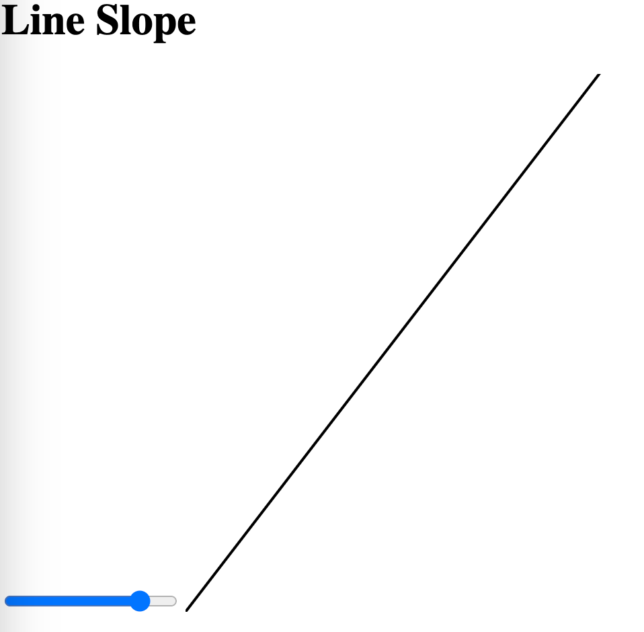
Simple Slope Lab
What is the “slope” of a line?
Can we generate a simple interactive demo? (yes!)
http://www.coderdojotc.org/chatgpt-for-teachers/prompts/10-slope-and-intercept/

Slide 37
Slope Lab Prompt
Prompt:
Create an HTML page that allows students to change the slope of a line.
Add an input range control slider that goes from -2 to 2 and controls
a JavaScript variable called "slope".
When the slider moves, update the slope of a line. Use a 400x400 SVG Grid.
Place the origin in the lower left corner.
http://www.coderdojotc.org/chatgpt-for-teachers/prompts/10-slope-and-intercept/

Slide 38
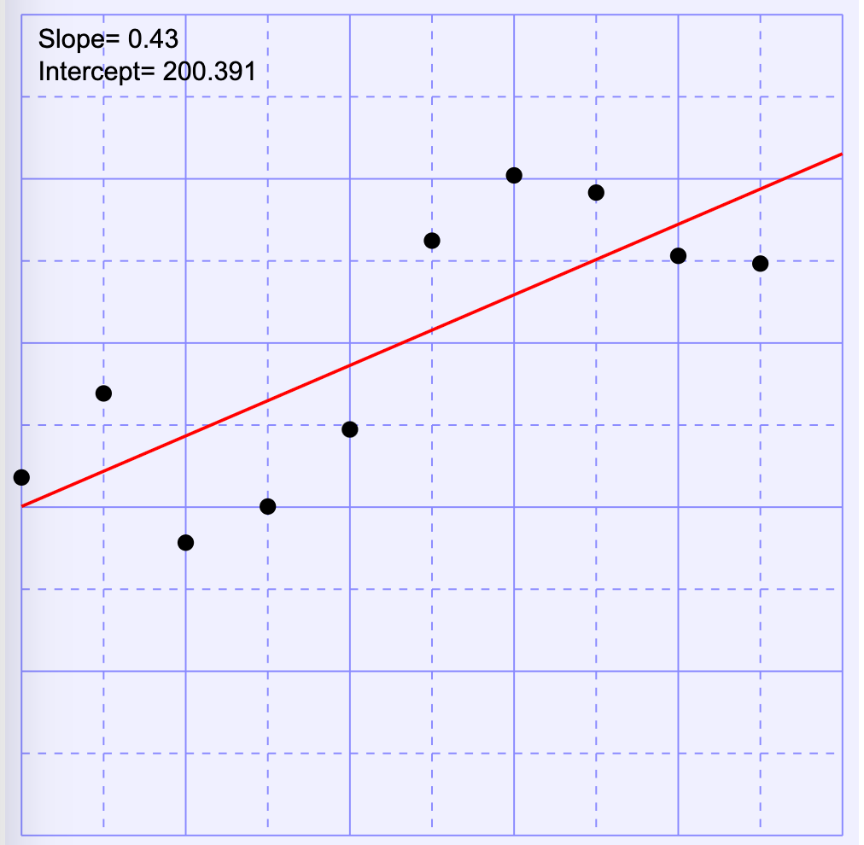
Least Square Fit
Tip: use your browser “refresh” to generate a new dataset.
http://www.coderdojotc.org/chatgpt-for-teachers/demos/grid-lines.html
Notes:
http://www.coderdojotc.org/chatgpt-for-teachers/prompts/25-linear-regression/

Slide 39
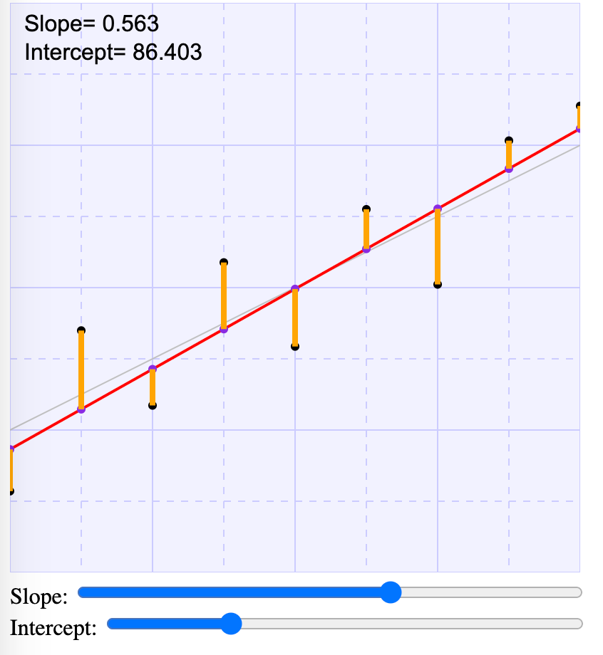
Least Square Fit Demo
Can we draw the distance from the data points to the regression line?
Can we see that by minimizing the orange line distances we can get the best fit?
How can we use the slope and intercept to create better predictions?
http://www.coderdojotc.org/chatgpt-for-teachers/demos/least-squares-1.html

Slide 40
Teaching Using Metaphors, Analogies and Stories
Prompt: Use an analogy to explain linear regression
Explain X so that a 5th grader can understand.
I would have never expected ChatGPT to be able to write analogies so well.
I like to get ChatGPT to explain difficult concepts as a dialogue between two characters.
I like to have ChatGPT make little rhyming poems of concepts to make them easier to remember.

Slide 41
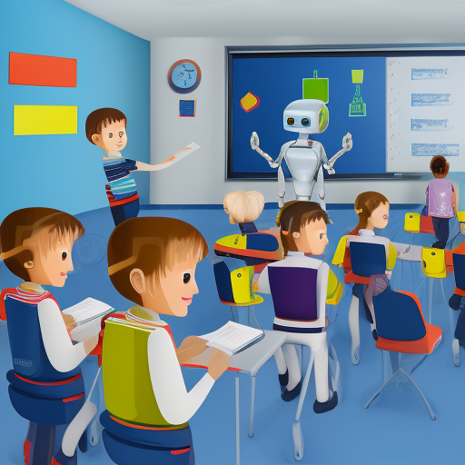
Future
Generative AI is in its infancy
Performance is doubling every 8-months
There are over 9,000 generative AI models (see HuggingFace.io)
GPT-4 has much higher quality and can analyze up to 32K tokens
New innovations weeks apart
LangChain
Auto-GPT
The pace of change is accelerating

Slide 42
Historical Perspective
Other
AI
The “generative turn”
Large language models move to the center of information systems integration
Agents speak in natural language, not APIs
Generative
AI
2022

Slide 43
In The Next Few Years
Prompt: Create a lesson plan for each of my students on linear regression. Adjust the complexity of the lesson to how students did on the prior quiz. Send the lessons out via e-mail with a return deadline of tomorrow at 5pm. Generate a multiple-choice quiz adjusted to each lesson. Send the quiz out the following day at 8am and have the results go into our Learning Management System. Analyze the results. Send the resulting reports to my email.

Slide 44
Ethical Considerations
When is it appropriate to automate the tedious parts of teaching?
How can these tools allow you to spend more time with your students?
When is it appropriate for us to disclose our use of these tools to our peers, parents and students?
Will AI use bias if they know the gender or race of a student?
When should these tools be regulated?

Slide 45
Summary
Generative AI can be a “force multiplier” in the classroom
Some teachers report less stress when they know they can leverage tools like ChatGPT
Lesson plans can be quickly customized to subgroups
Always verify content for correctness (humans-in-the-loop)
Teach prompt engineering in your classroom
Have fun!

Slide 46
Thank You!
Dan McCreary
Contact: https://www.linkedin.com/in/danmccreary/

